Slide 1
Car2know
“ No more or know more, that is the question ”
Xiasen Wang
Yuxuan Cheng
Geng Zeng
Zhe He

Slide 2
Contents
Introduction & Motivation
Data Sets
Use Cases
Design
Demonstration

Slide 3
MOTIVATION
Emerging Uber, Lyft and Car2Go have become important means of transportation in our daily life. Our group want to analyze the Car2Go flux information based on the census blocks in Seattle as well as visualize it in Python. It will provide insight into the supply and demand for customers, car rental companies, as well as city planners and business analysts.

Slide 4
DATA SETS
Car2Go API Query
(txt file)
Hle Census Block Map
(ArcGIS format)
Time
Location
Car ID
Fuel level
shp
dbf
sbn
shx

Slide 5
USE CASES
A visualization interface for the general public to look up Car2go availability in selected regions.
A simple exploratory data analysis tool of Car2Go supply and demand on a census-block level.
A second layer of the flux information grouped by census tracts (groups of census blocks) for better visualization.

Slide 6
DESIGN
Collect Car2go data
Map the trips
Visualization
Use Urllib2 to deal with the raw data
Use arcpy package to combine the 2 datasets
Map the flux per block in Python.
Calculate trips
Calculate flux
Connect the “loose ends” in stacks of “snapshots”
Group influx and outflux by hours

Slide 7
DEMONSTRATION
Know More >

Slide 8
Pick Data
Using car2go API to request data in Seattle every 30 seconds
Return information of all available cars’ information
Compare two adjacent data:
If a car appears: a trip ends
If a car disappears: a trip starts
Data are from January to May in Seattle, and there are about 330,000 trips in total

Slide 9
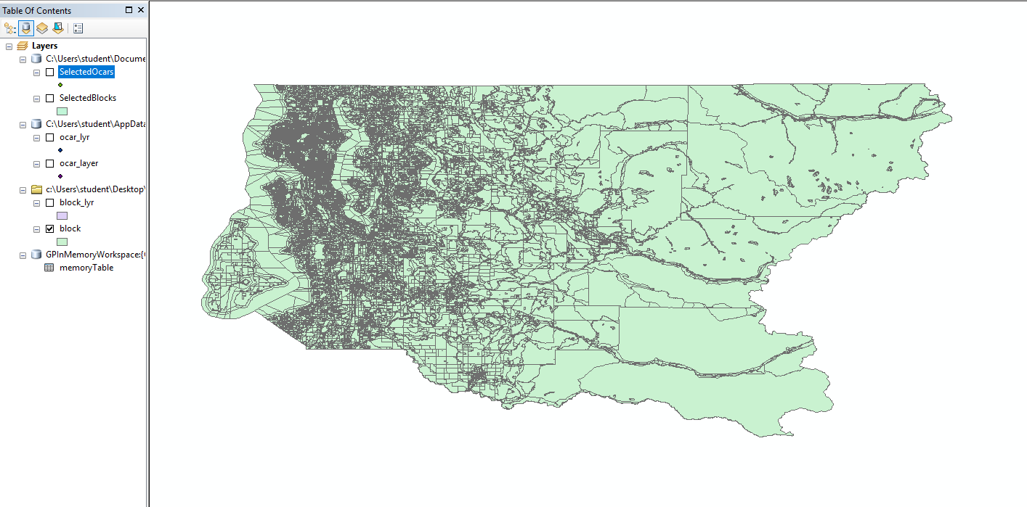
Data in ArcGIS
import arcpy
import arcpy.mapping
path = "c:/Users/student/Destop/O"
arcpy.env.workspace = path
mxd = arcpy.mapping.MapDocument("CURRENT")
df = arcpy.mapping.ListDataFrames(mxd,"*")[0]
arcpy.MakeFeatureLayer_management('c:\Users\student\Desktop\O\kc_block_10.shp','block')

Slide 10
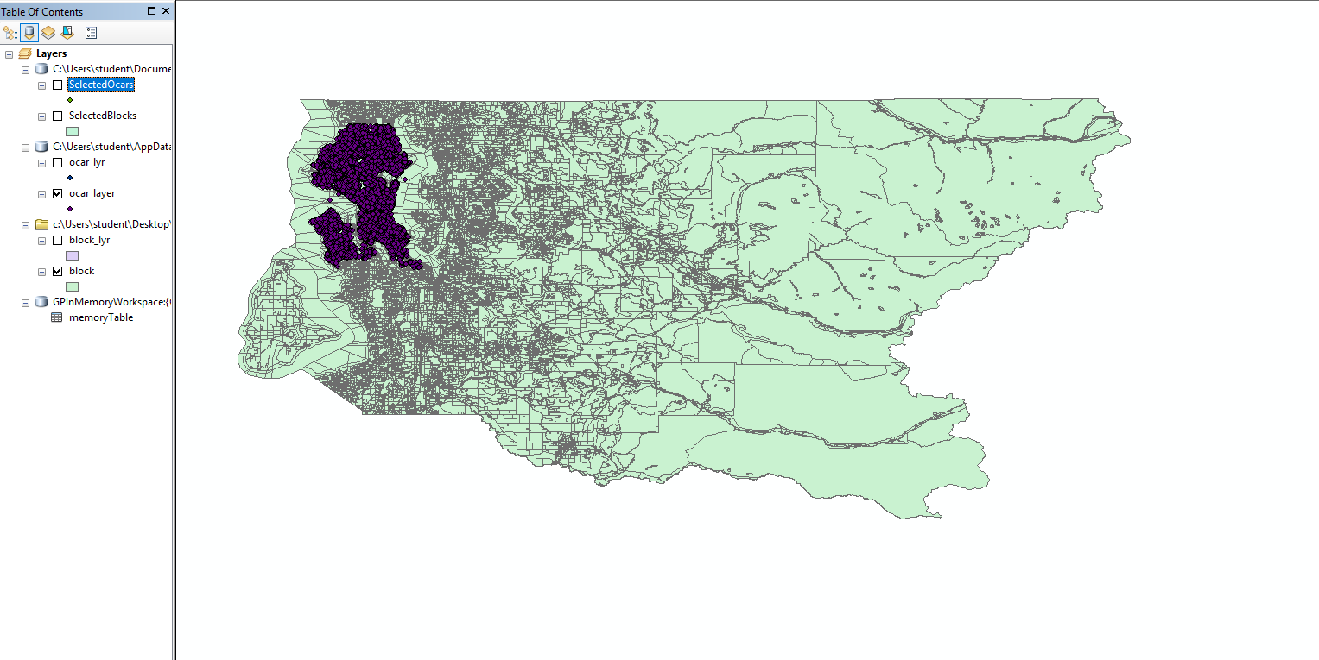
Data in ArcGIS
arcpy.MakeXYEventLayer_management("memoryTable", "olon", "olat", "ocar_layer",r"Coordinate Systems\Geographic Coordinate System\North America\Nad 1983","")
arcpy.MakeFeatureLayer_management('block', 'block_lyr')
arcpy.SelectLayerByLocation_management('block_lyr', 'intersect', 'ocar_layer')

Slide 11
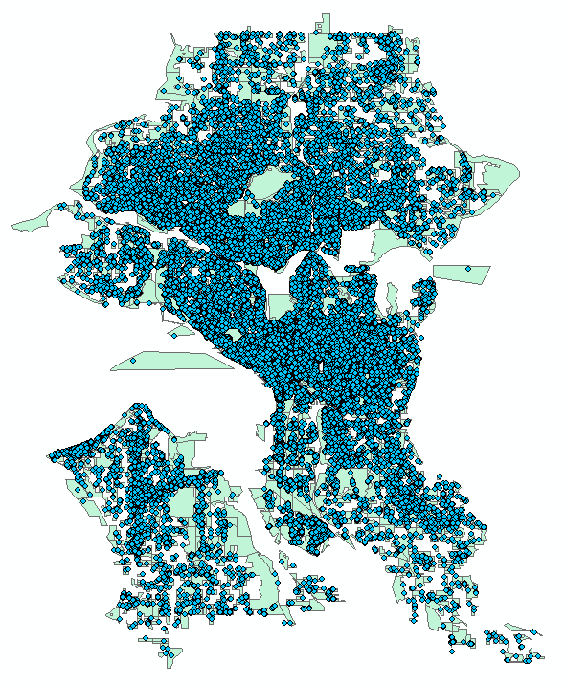
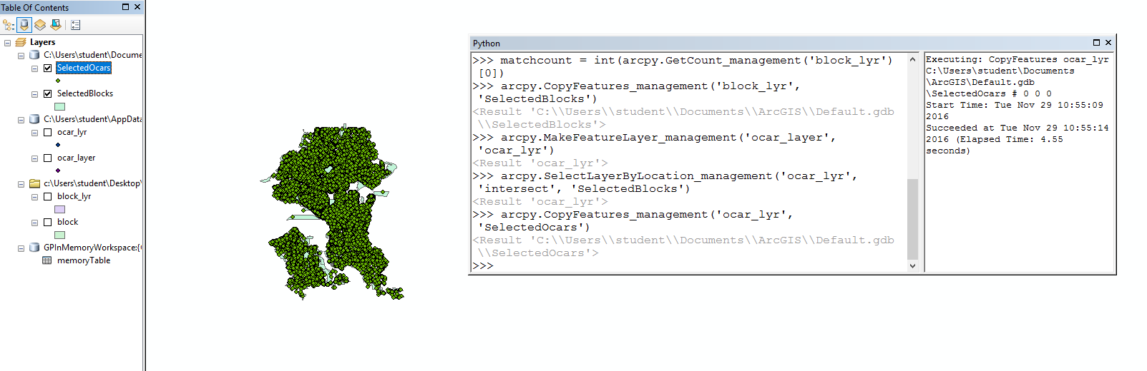
Data in ArcGIS

Slide 12
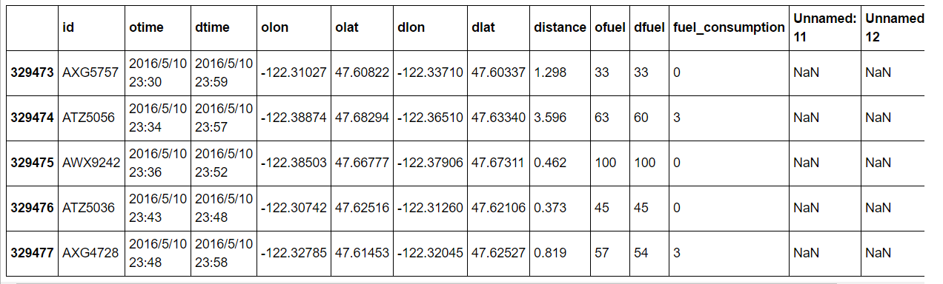
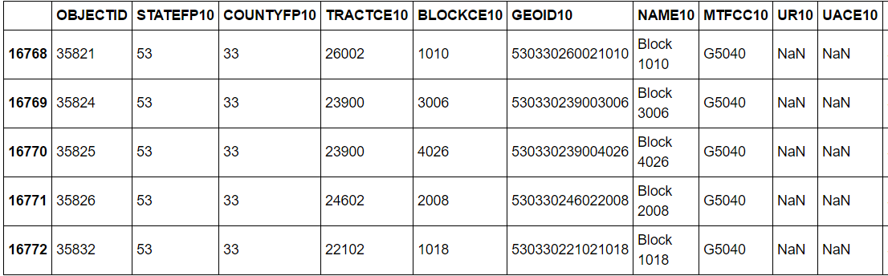
Data Calculation
Car2go data
~330k trips
unique identifiers
Blocks data
~17k blocks

Slide 13
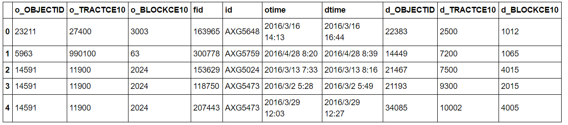
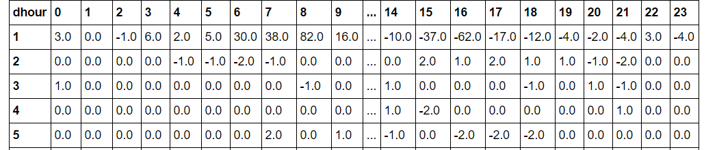
Data Calculation
Combined data
by destination or origin
Output: Flux data
9020 x 24 (blocks)
495 x 24 (tracts)

Slide 14
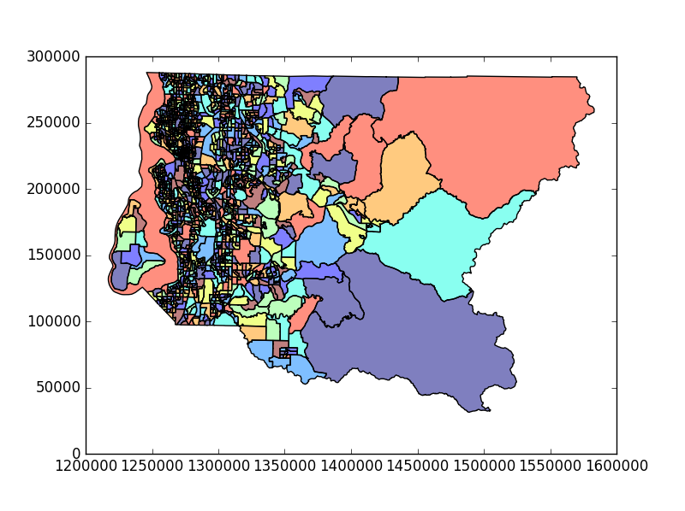
Visualization
pip install fiona
git clone https://github.com/geopandas/geopandas.git
cd geopandas
pip install
import shapely
import geopandas as gpd
import pysal
from scipy import ndimage
GeoPandas
An open source project to make working with geospatial data in python easier
GeoPandas extends the datatypes used by pandas
A GeoDataFrame is a tabular data structure that contains a GeoSeries
Always has one GeoSeries column that holds a special status. This GeoSeries is referred to as the Geo DataFrame‘s “geometry”
Geometric Objects (actually shapely objects):
Points / Multi-Points
Lines / Multi-Lines
Polygons / Multi-Polygons

Slide 15
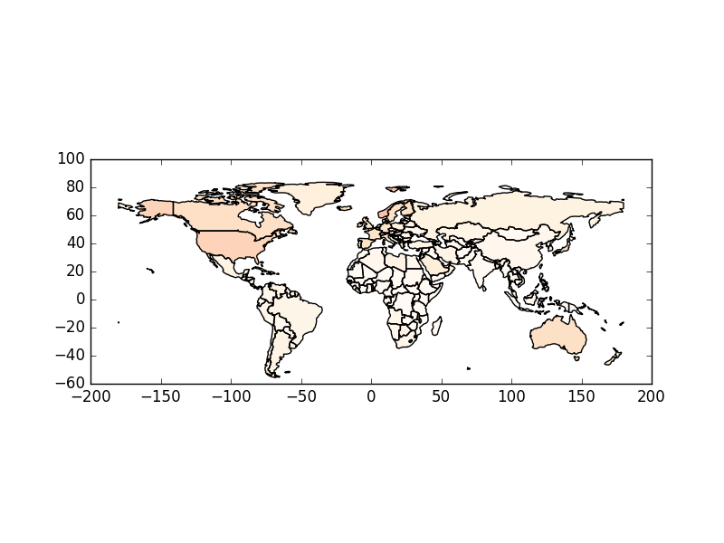
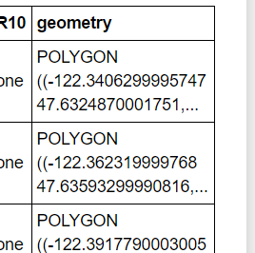
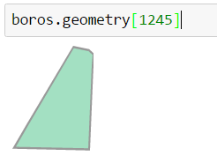
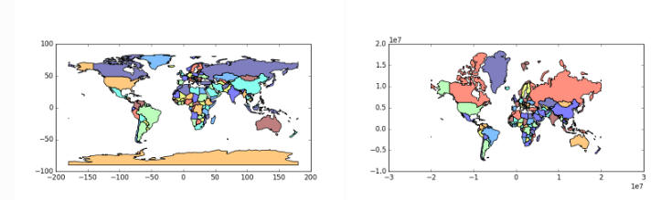
Visualization
Mapping shapes
flux_map.plot(column = str(hour), cmap = cmapstr,figsize = (size))
Reading Spatial Data
gpd.GeoDataFrame.from_file(‘*.shp')
“geometry”
Projections

Slide 16
Point map
Heat map

Slide 17
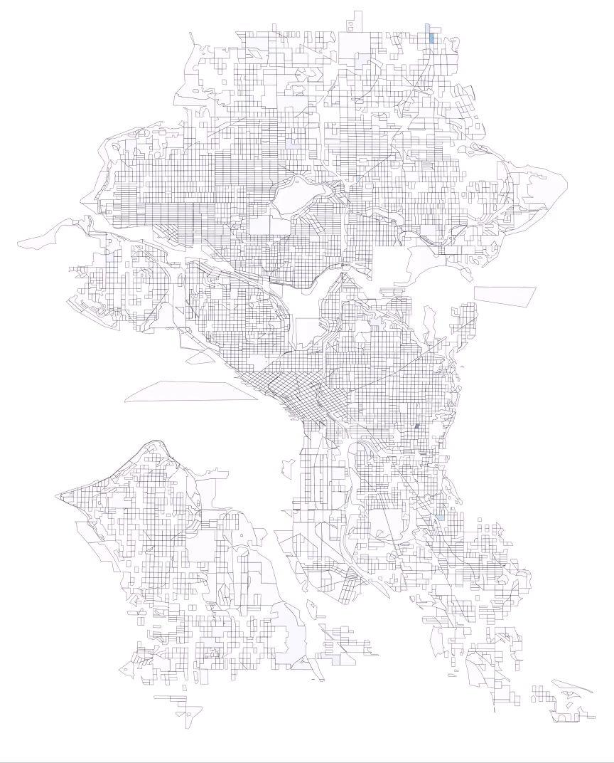
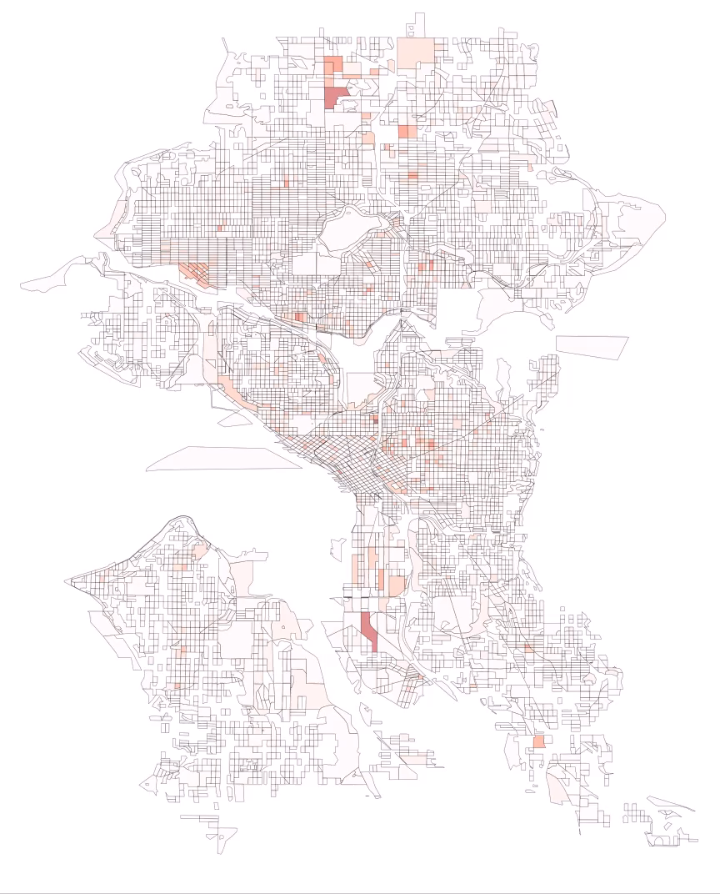
Flux in
Flux out

Slide 18
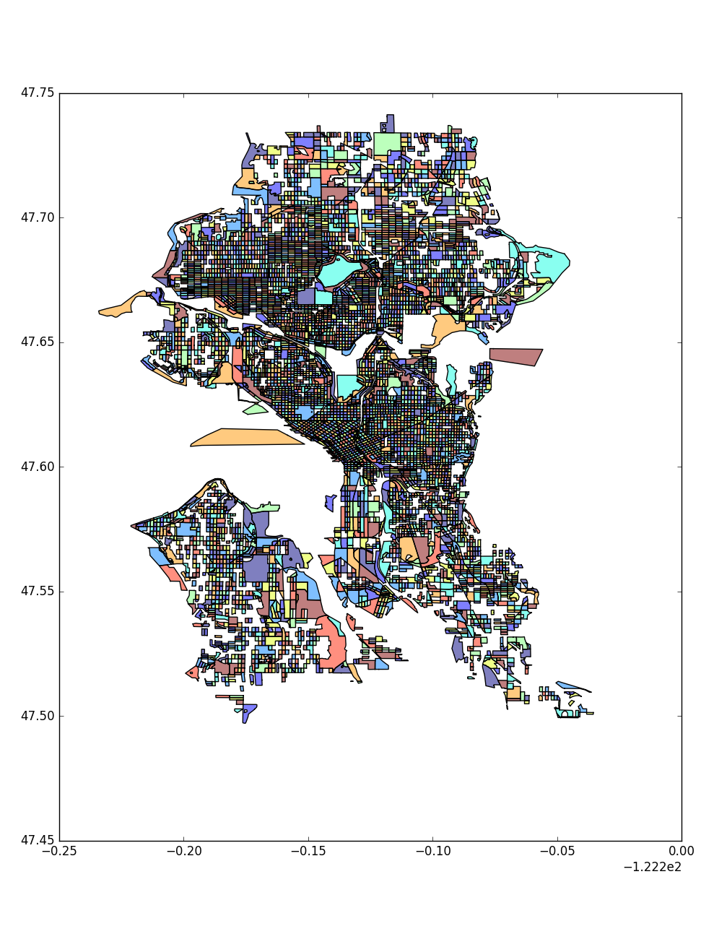
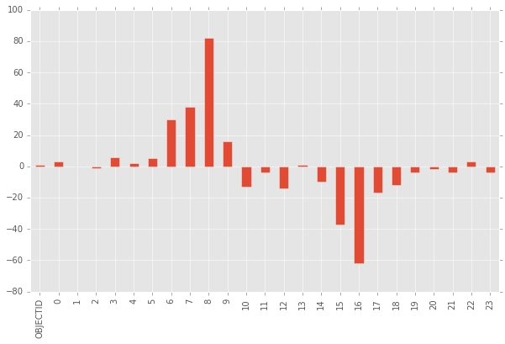
In
Out
Hour

Slide 19
THANK YOU

